Slide 1
Head & Neck Contouring
Hasan Murshed, M.D., M.S.
Medical Director
Hope Regional Cancer Center
Panama City, FL, USA

Slide 2
Items
Head and neck sites
Head and vessels
Head and muscles
They drain to different areas of the lymphatic region
Lymphatic region is complex
Describe the different levels of the LNs
Show anatomy and CT scans
Describe LN contouring guidelines
Contour levels of LNs
Show isodose lines and DVHs

Slide 3
H&N - Sites
Nasopharynx
Anterior-superiorly from posterior choana (opening between the nasal cavity and nasopharynx), inferiorly to the superior surface of the soft palate.
Oral Cavity
Consists of the lips, buccal mucosa, upper alveolar, ridge, lower alveolar ridge, retromolar trigone (small triangular surface, posterior to last molar, overlying the ascending ramus), floor of mouth (FOM), hard palate, and the anterior two-thirds of the tongue.
Oropharynx
Superiorly from the inferior surface of the soft palate, inferiorly to the inferior border of the hyoid bone.
Consists of BOT, ant/post tonsillar pillars and tonsils, uvula, soft palate.
Hypopharynx
Superiorly from the inferior border of the hyoid bone, inferiorly to the inferior border of cricoid cartilage.
Consists of PS, post pharyngeal wall, postcricoid region

Slide 4
H&N - Sites
Larynx
Supraglottis
Superiorly from the tip of the epiglottis, inferiorly to a horizontal plane passing through the apex of the ventricle.
Consists of epiglottis, AE folds including arytenoids, false VC and ventricles, lower boundary of the horizontal plane passing through the apex of ventricle
Glottis
Superiorly from the lateral margin of the ventricle extending 1 cm inferiorly
Consists of True VC and ant/post commisures
Subglottis
Superiorly from the lower boundary of the glottis, inferiorly to the lower margin of the cricoid.

Slide 5
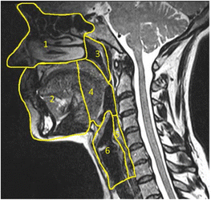
H&N - Sites
1. Nasal cavity/paranasal sinuses
2. Oral cavity/lips
3. Nasopharynx
4. Oropharynx
5. Hypopharynx
6. Larynx

Slide 6
H&N - Vessels

Slide 7
H&N - Muscles
Sternocleidomastoid originates at the manubrium of the sternum (sterno-) and the clavicle (cleido-), and has an insertion at the mastoid process of the temporal bone of the skull.
The scalene muscles originate from the transverse processes from the cervical vertebrae of C2 to C7 and insert onto the first and second ribs.

Slide 8
H&N – Sites, Vessels, Muscles

Slide 9
H&N – CT Scans

Slide 10
H&N – CT Scans

Slide 11
H&N – CT Scans

Slide 12
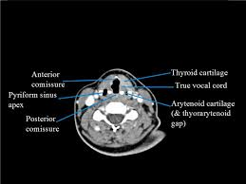
H&N – CT Scans

Slide 13
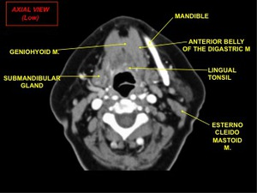
H&N – CT Scans

Slide 14
H&N – LN levels

Slide 15
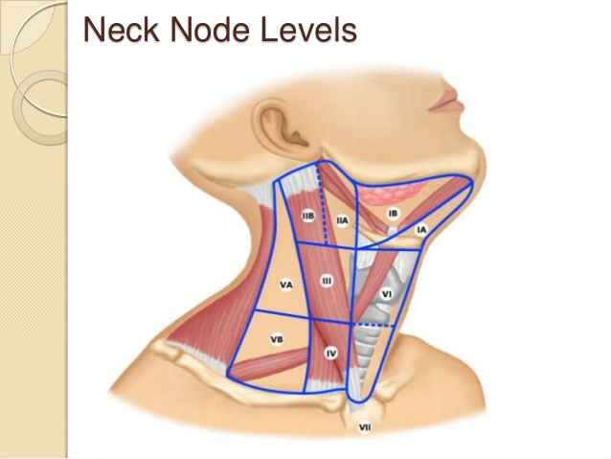
H&N – LN Levels

Slide 16
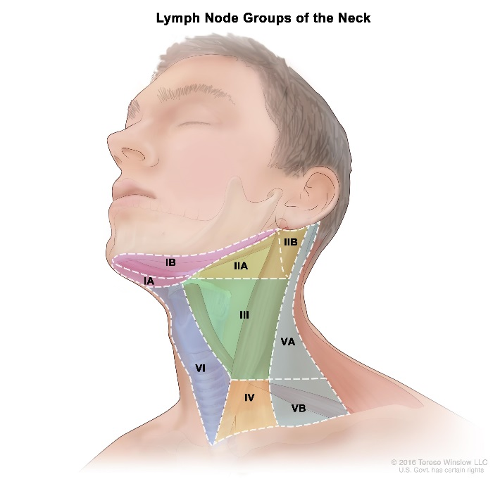
H&N – LN Levels

Slide 17
H&N – LN Levels

Slide 18
H&N - Levels

Slide 19
H&N – Consensus Guidelines
Superficial (top) and deep (bottom) lymphatic node groups of the head and neck. These groups are named according to the node levels modified from Robbins classification (see Table 1) [modified from Lengelé [11]. AJ: anterior jugular; B: buccal; diP: deep intraparotid; F: facial; iH: infrahyoid; M: malar; Mt: mastoid; pA: preauricular; pL: prelaryngeal; pT: pretracheal; R: recurrent or paratracheal; sA: subauricular; SAN: spinal accessory nerve; SEJ: superficial external jugular; siP: superficial intraparotid; sMb: submandibular; sMt: submental; sP: subparotid; TCA: transverse cervical artery.

Slide 20
H&N – Consensus Guidelines
Head and neck CT sections performed on a 32 year-old volunteer immobilized with a head-neck-shoulder thermoplatic mask. The head was set in a “neutral” position. Sixty ml of iodinated contrast medium (Omnipaque 350, HealthCare, Diegem, BE) was injected intravenously at a rate of 1 ml/s, then after a 3-min gap, another 50 ml were injected at a rate of 1.5 ml/s. The examination was performed on a Toshiba (Toshiba Aquilon LB, Toshiba Medical System corporation, Japan) helicoidal CT (300 mAs and 120 keV) using a slice thickness of 2.0 mm, an interval reconstruction of 2.0 mm and a helicoidal pitch of 11. CT sections were reconstructed using a 512 × 512 matrix. Sections were taken at the level of the top edge of C1 (panel A), the bottom edge of C2 (panel B), mid C4 (panel C), the bottom edge of C6 (panel D), mid Th1 (panel E), and top edge of Th2 (panel F). Neck node levels were drawn on each CT slice using the radiological boundaries detailed in Table 1. Each node level corresponds to node groups, and thus does not include any security margin for organ motion or set-up inaccuracy. 1: common carotid artery; 2: internal carotid artery; 3: external carotid artery; 4: internal jugular vein; 5: external jugular vein; 6: anterior jugular vein; 7: right brachiocephalic trunc; 8: right brachiocephalic vein; 9: left susclavian artery; 10: left susclavian vein; 11: facial vessels; 12: masseter m.; 13: pterygoid m.; 14: longus capitis m.; 15: longus colli m.; 16: sternocleidomastoid m.; 17: digastric (ant. belly) m.; 18: digastric (post. belly) m.; 19: platysma m. 20: trapezius m.; 21: splenius capitis m.; 22: scalenius m.; 23: levator scapulae m.; 24: serratus anterior m.; 25: thyro-hyoid m.; 26: sterno-hyoid m.; 27: parotid gland; 28: sub-mandibular gland; 29: thyroid gland; 30: mastoid; 31: styloid process; 32: mandible; 33: maxilla; 34: hyoid bone; 35: odontoid process; 36: 2nd cervical vertebra; 37: 4th cervical vertebra; 38: 6th cervical vertebra; 39: thyroid cartilage; 40: cricoid cartilage; 41: clavicle; 42: 1st thoracic vertebra; 43: 2nd thoracic vertebra; 44: rib; 45: lung apex; 46: esophagus; 47: Bichat’s fat pad; 48: pre-styloid para-pharyngeal space.

Slide 21
H&N – Consensus Guidelines
Head and neck CT sections performed on a 32 year-old volunteer immobilized with a head-neck-shoulder thermoplatic mask. The head was set in a “neutral” position. Sixty ml of iodinated contrast medium (Omnipaque 350, HealthCare, Diegem, BE) was injected intravenously at a rate of 1 ml/s, then after a 3-min gap, another 50 ml were injected at a rate of 1.5 ml/s. The examination was performed on a Toshiba (Toshiba Aquilon LB, Toshiba Medical System corporation, Japan) helicoidal CT (300 mAs and 120 keV) using a slice thickness of 2.0 mm, an interval reconstruction of 2.0 mm and a helicoidal pitch of 11. CT sections were reconstructed using a 512 × 512 matrix. Sections were taken at the level of the top edge of C1 (panel A), the bottom edge of C2 (panel B), mid C4 (panel C), the bottom edge of C6 (panel D), mid Th1 (panel E), and top edge of Th2 (panel F). Neck node levels were drawn on each CT slice using the radiological boundaries detailed in Table 1. Each node level corresponds to node groups, and thus does not include any security margin for organ motion or set-up inaccuracy. 1: common carotid artery; 2: internal carotid artery; 3: external carotid artery; 4: internal jugular vein; 5: external jugular vein; 6: anterior jugular vein; 7: right brachiocephalic trunc; 8: right brachiocephalic vein; 9: left susclavian artery; 10: left susclavian vein; 11: facial vessels; 12: masseter m.; 13: pterygoid m.; 14: longus capitis m.; 15: longus colli m.; 16: sternocleidomastoid m.; 17: digastric (ant. belly) m.; 18: digastric (post. belly) m.; 19: platysma m. 20: trapezius m.; 21: splenius capitis m.; 22: scalenius m.; 23: levator scapulae m.; 24: serratus anterior m.; 25: thyro-hyoid m.; 26: sterno-hyoid m.; 27: parotid gland; 28: sub-mandibular gland; 29: thyroid gland; 30: mastoid; 31: styloid process; 32: mandible; 33: maxilla; 34: hyoid bone; 35: odontoid process; 36: 2nd cervical vertebra; 37: 4th cervical vertebra; 38: 6th cervical vertebra; 39: thyroid cartilage; 40: cricoid cartilage; 41: clavicle; 42: 1st thoracic vertebra; 43: 2nd thoracic vertebra; 44: rib; 45: lung apex; 46: esophagus; 47: Bichat’s fat pad; 48: pre-styloid para-pharyngeal space.

Slide 22
H&N – Consensus Guidelines
Head and neck CT sections performed on a 32 year-old volunteer immobilized with a head-neck-shoulder thermoplatic mask. The head was set in a “neutral” position. Sixty ml of iodinated contrast medium (Omnipaque 350, HealthCare, Diegem, BE) was injected intravenously at a rate of 1 ml/s, then after a 3-min gap, another 50 ml were injected at a rate of 1.5 ml/s. The examination was performed on a Toshiba (Toshiba Aquilon LB, Toshiba Medical System corporation, Japan) helicoidal CT (300 mAs and 120 keV) using a slice thickness of 2.0 mm, an interval reconstruction of 2.0 mm and a helicoidal pitch of 11. CT sections were reconstructed using a 512 × 512 matrix. Sections were taken at the level of the top edge of C1 (panel A), the bottom edge of C2 (panel B), mid C4 (panel C), the bottom edge of C6 (panel D), mid Th1 (panel E), and top edge of Th2 (panel F). Neck node levels were drawn on each CT slice using the radiological boundaries detailed in Table 1. Each node level corresponds to node groups, and thus does not include any security margin for organ motion or set-up inaccuracy. 1: common carotid artery; 2: internal carotid artery; 3: external carotid artery; 4: internal jugular vein; 5: external jugular vein; 6: anterior jugular vein; 7: right brachiocephalic trunc; 8: right brachiocephalic vein; 9: left susclavian artery; 10: left susclavian vein; 11: facial vessels; 12: masseter m.; 13: pterygoid m.; 14: longus capitis m.; 15: longus colli m.; 16: sternocleidomastoid m.; 17: digastric (ant. belly) m.; 18: digastric (post. belly) m.; 19: platysma m. 20: trapezius m.; 21: splenius capitis m.; 22: scalenius m.; 23: levator scapulae m.; 24: serratus anterior m.; 25: thyro-hyoid m.; 26: sterno-hyoid m.; 27: parotid gland; 28: sub-mandibular gland; 29: thyroid gland; 30: mastoid; 31: styloid process; 32: mandible; 33: maxilla; 34: hyoid bone; 35: odontoid process; 36: 2nd cervical vertebra; 37: 4th cervical vertebra; 38: 6th cervical vertebra; 39: thyroid cartilage; 40: cricoid cartilage; 41: clavicle; 42: 1st thoracic vertebra; 43: 2nd thoracic vertebra; 44: rib; 45: lung apex; 46: esophagus; 47: Bichat’s fat pad; 48: pre-styloid para-pharyngeal space.

Slide 23
H&N – LN drainage
Mucosal Site Likely LN drainage levels
IB (submandibular)
NP, OP II (high jugular)
NP, OP, HP, SGL, GL II, III (high midjugular)
OP, HP, SGL, GL III (mid jugular)
HP, SGL, GL IV (inferior jugular)
NP, skin V (post cervical triangle)

Slide 24
H&N – Cervical LN metastases
Ipsilateral Contralateral
Tumor Site: LNs at Risk* (%) (%)
Nasopharynx: upper post cervical, superior deep jugular, subdiagastric 80 40
BOT: subdiagastric, superior deep jugular, submandibular 75 40
Tonsil fossa: subdigastric, sup deep jugular, mid jugular 75 10
Hypopharynx: subdigastric, mid jugular, low jugular 75 10
Supra glottis: subdigastric, mid jugular, low jugular 55 15
Soft palate: subdigastric, mid jugular 40 15
Tonsilar pillar: subdigastric, submandibular 40 5
Oral tongue: subdigastric, mid jugular, submandibular 35 5
FOM: subdigastric, submandibular 25 <5
Glottis: T1 0
T2 <5
T3–4 25
Lip commissure 20
Lip: submental, submandible, subdigastric, parotid, buccinators 10
Subglottis 10

Slide 25
H&N – Volumes
Patients are supine, face mask on, arms strapped down, IV contrast in, tongue blade in if indicated, bolus as needed, patients are CT simulated. Use 9 equally spaced coplanar 6 MV photon beams for planning. Alternatively 2 arcs for VMAT planning are used.
Volumes
GTV = gross disease + enlarged lymph nodes (LNs), as seen on CT, MRI, or PET scans
CTV1 = GTV + subclinical disease around GTV + ipsilateral and contralateral at risk LNs + 0.5-1 cm around primary and 0.3-0.5 cm around LNs, respecting tissue boundaries
CTV2 = GTV + subclinical disease around GTV + ipsilateral at risk LNs + 0.5-1 cm around primary and 0.3-0.5 cm around LNs, respecting tissue boundaries
CTV3 = GTV + 0.5-1 cm around primary and 0.3-0.5 cm around LNs, respecting tissue boundaries
PTV = CTV + 0.3-0.5 cm (0.5-1 cm around Larynx for intrafraction motion)

Slide 26
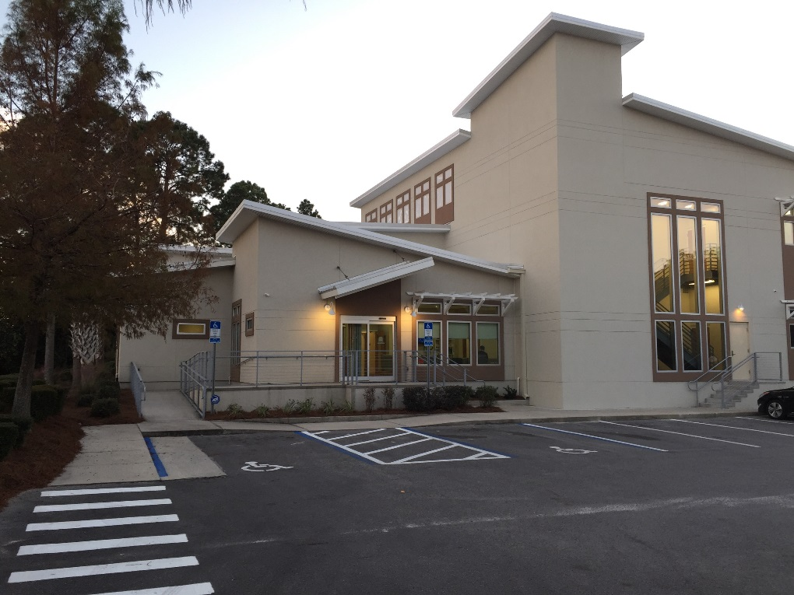
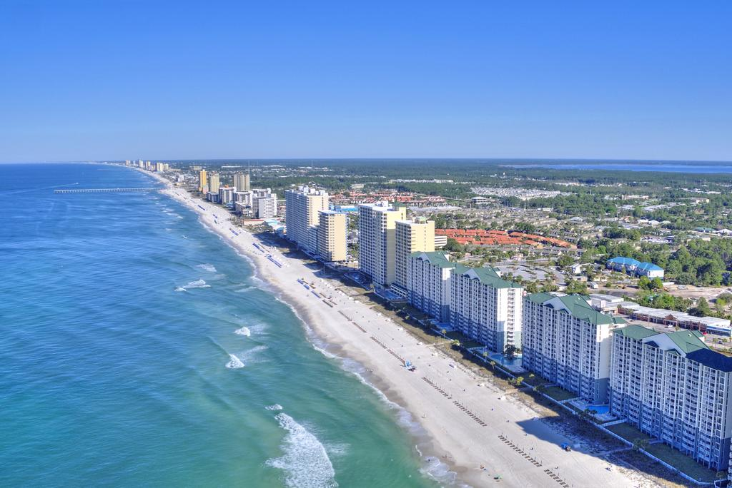
Conclusions

